Slide 1
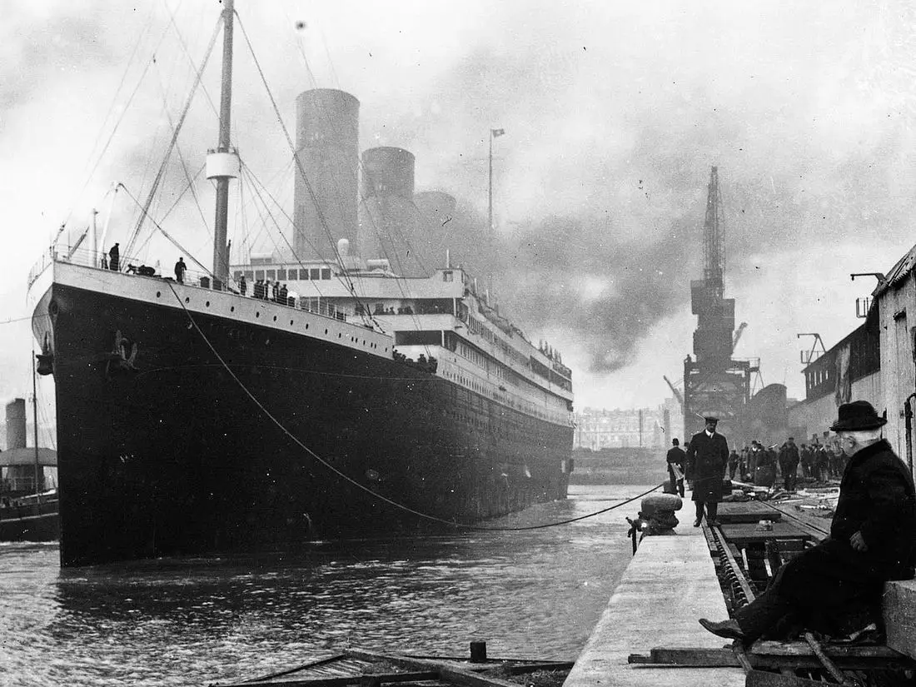

Sailing Through Time: A Titanic Data Odyssey
Abel, Emily, Leah, Mulugeta

Slide 2
Our Data
Kaggle Dataset - Titanic Machine Learning from Disaster
https://www.kaggle.com/competitions/titanic/data
Created for the purposes of a competition which is currently ongoing
12 Columns of Data: Passenger ID, Survived, Class, Name, Sex, Age, Sibling/Spouse onboard, Parent/Child onboard, Ticket Number, Fare (Cost), Cabin, and Embarkation Port
Cabin column had majority null values
Grouped Ages for visualizations: 0-12 was a child, 13-18 was a teenager, 19-65 was an adult, and 65+ was a senior.
Grouped Fares
Grouped Parent/Child onboard with Sibling/Spouse onboard
891 Rows of Data
Data is based on Passengers. While there were more people aboard, over 900 were crew.

Slide 3
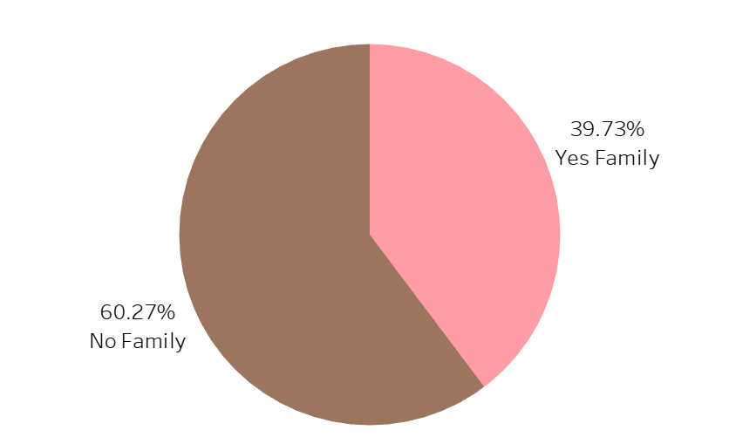
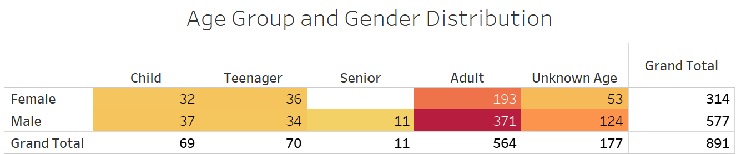
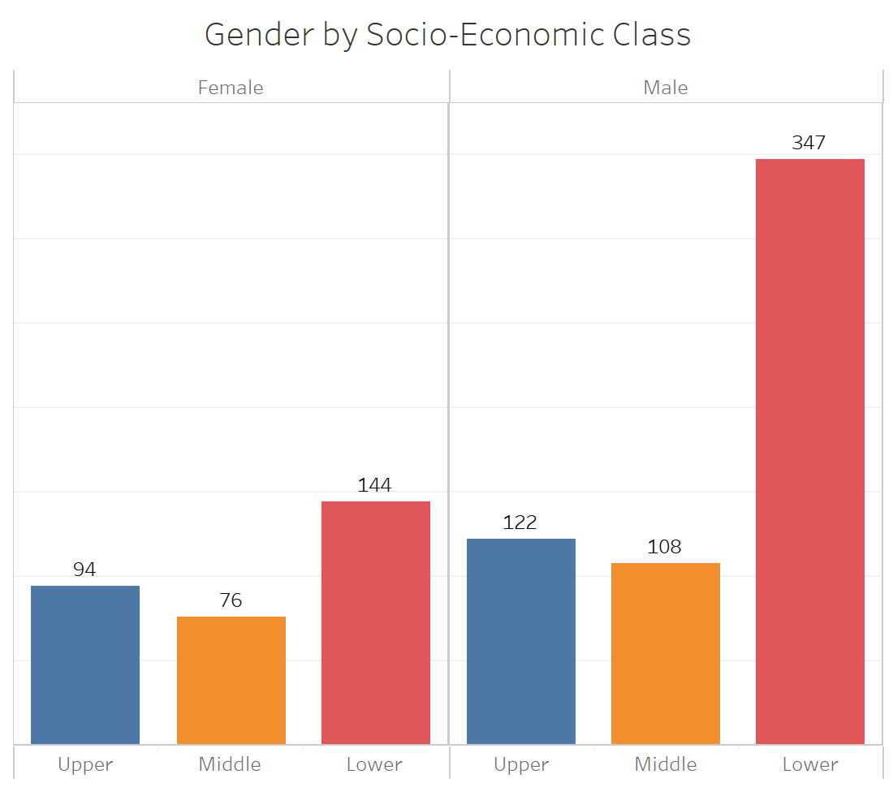
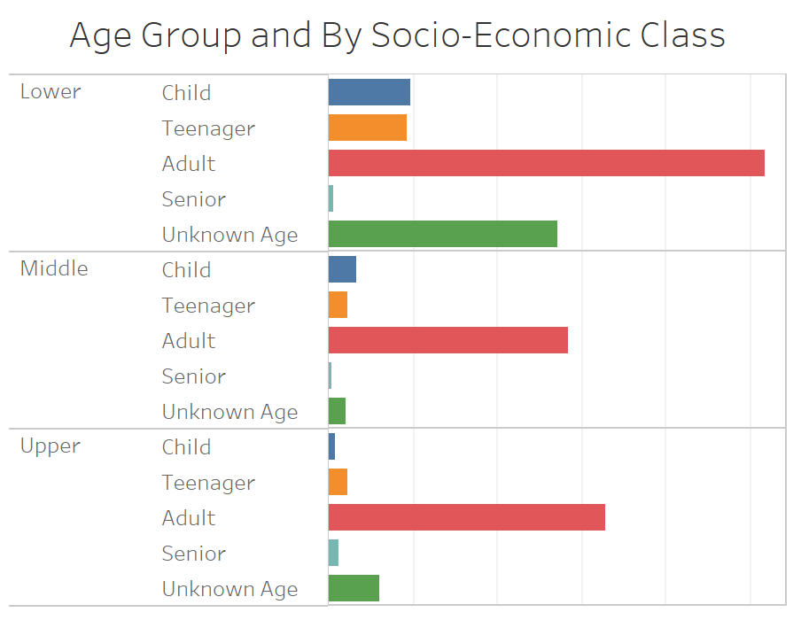
Exploratory Analysis Visualizations

Slide 4
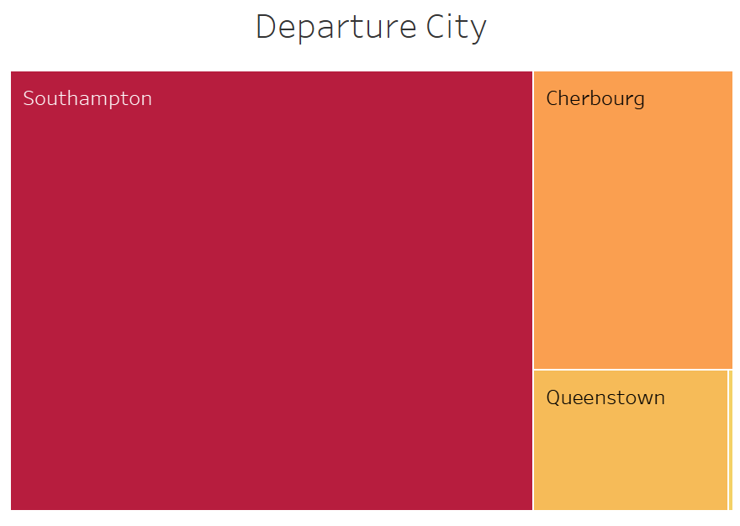
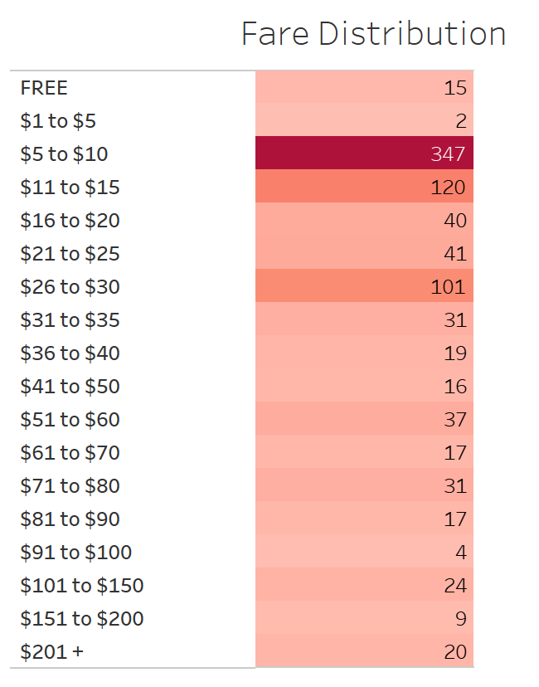
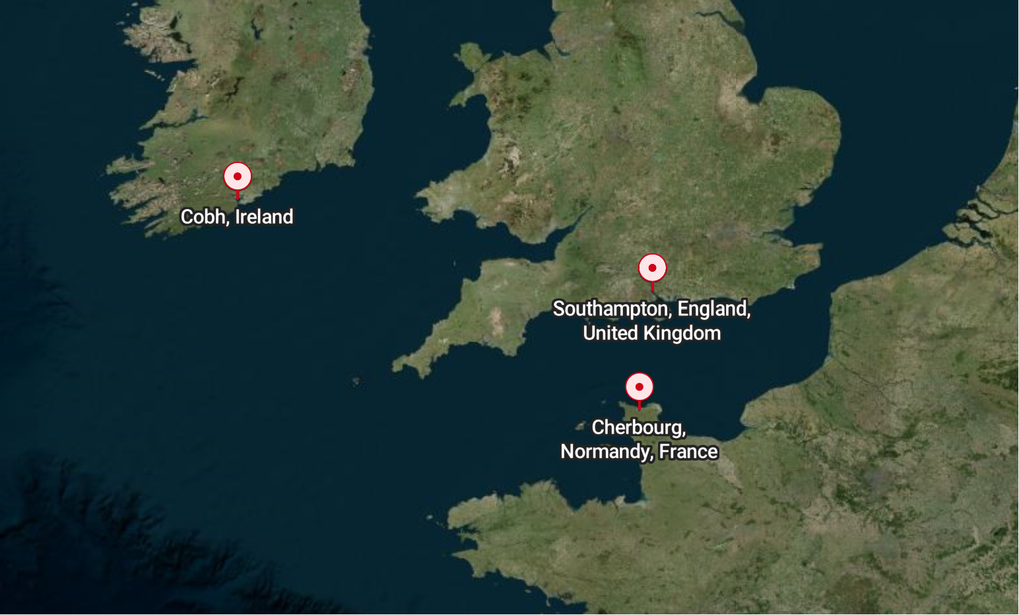
Exploratory Analysis Visualizations

Slide 5
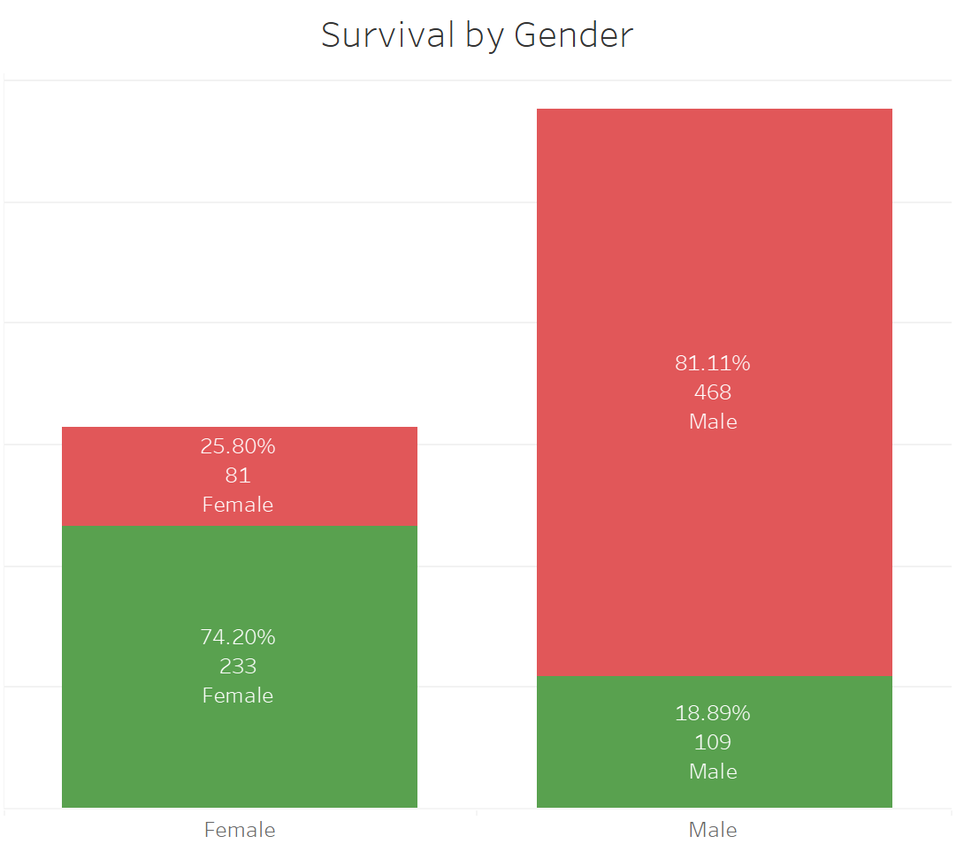
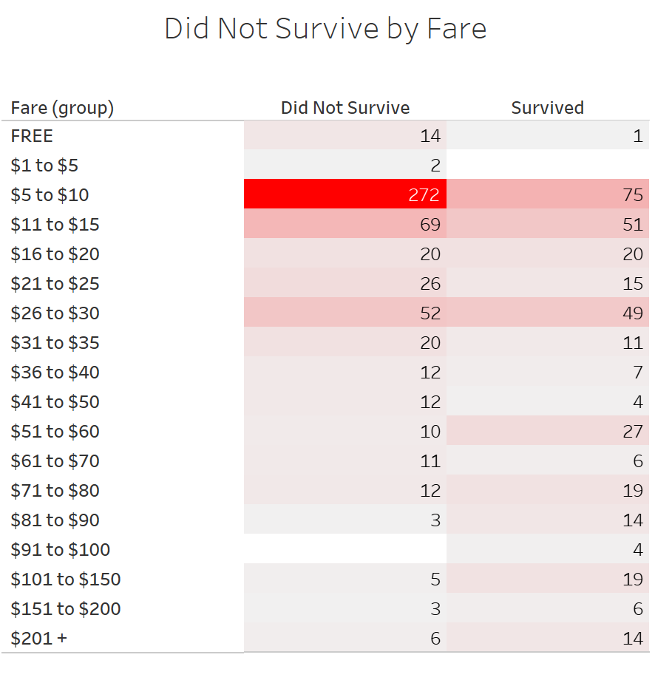
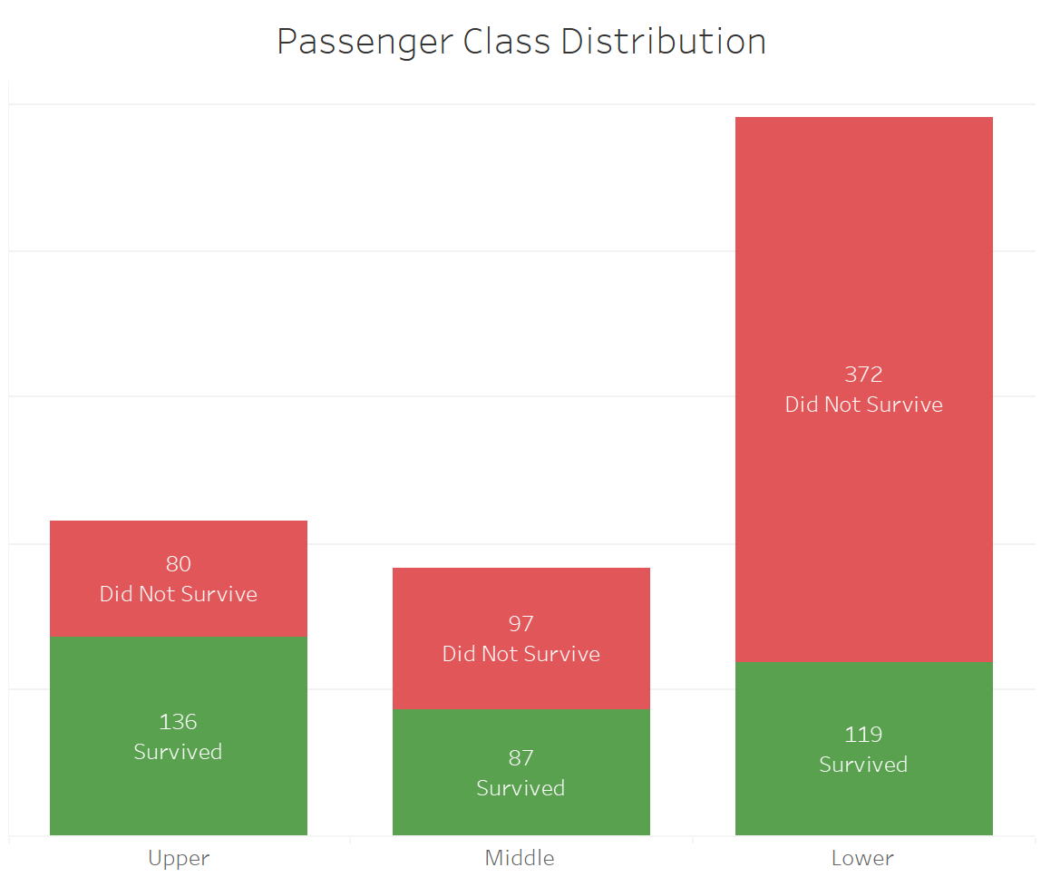
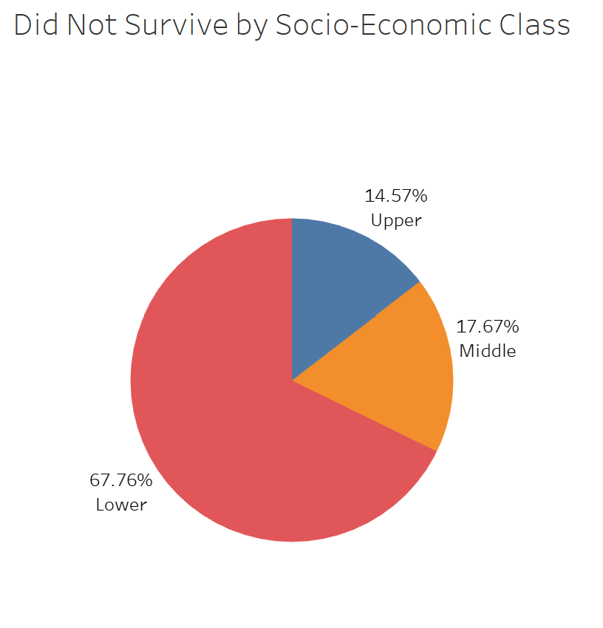
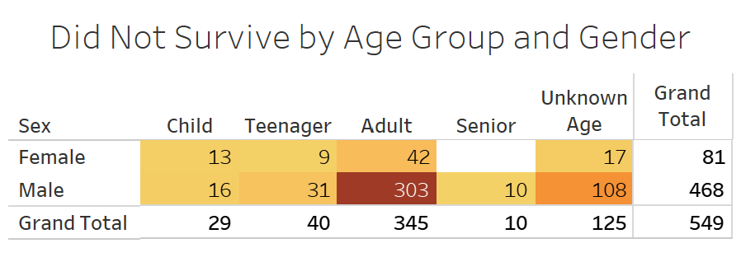
Drowning in Data

Slide 6
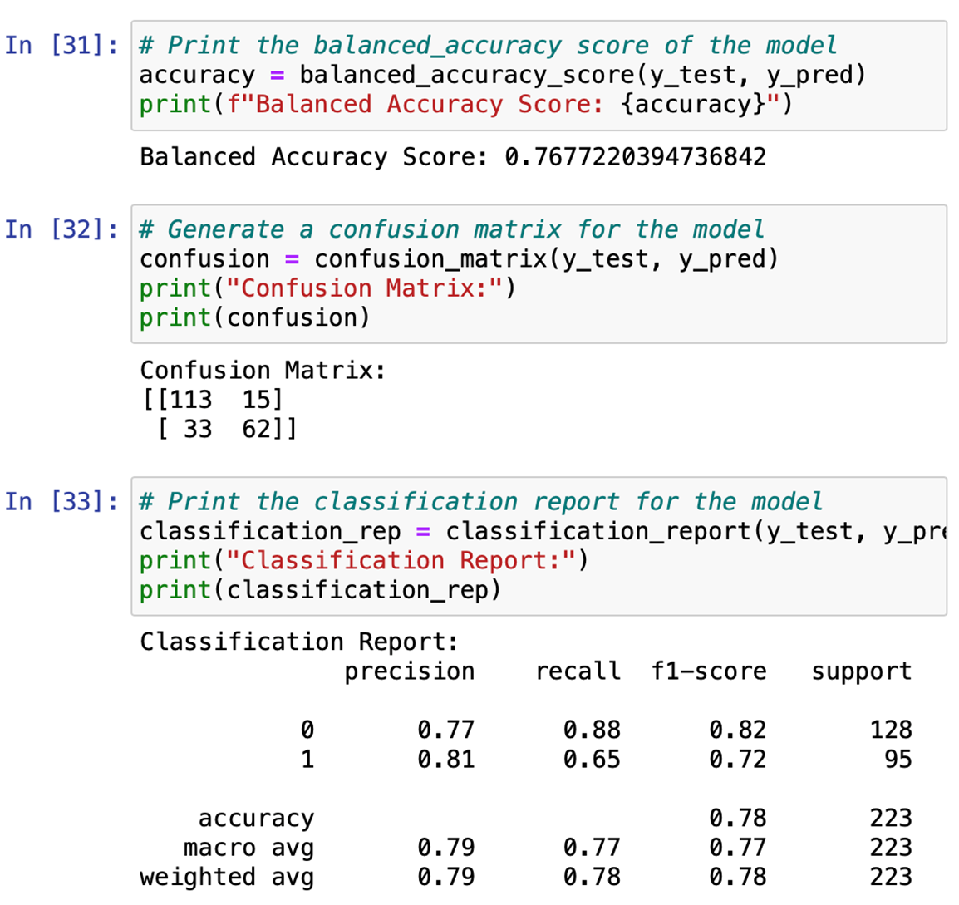
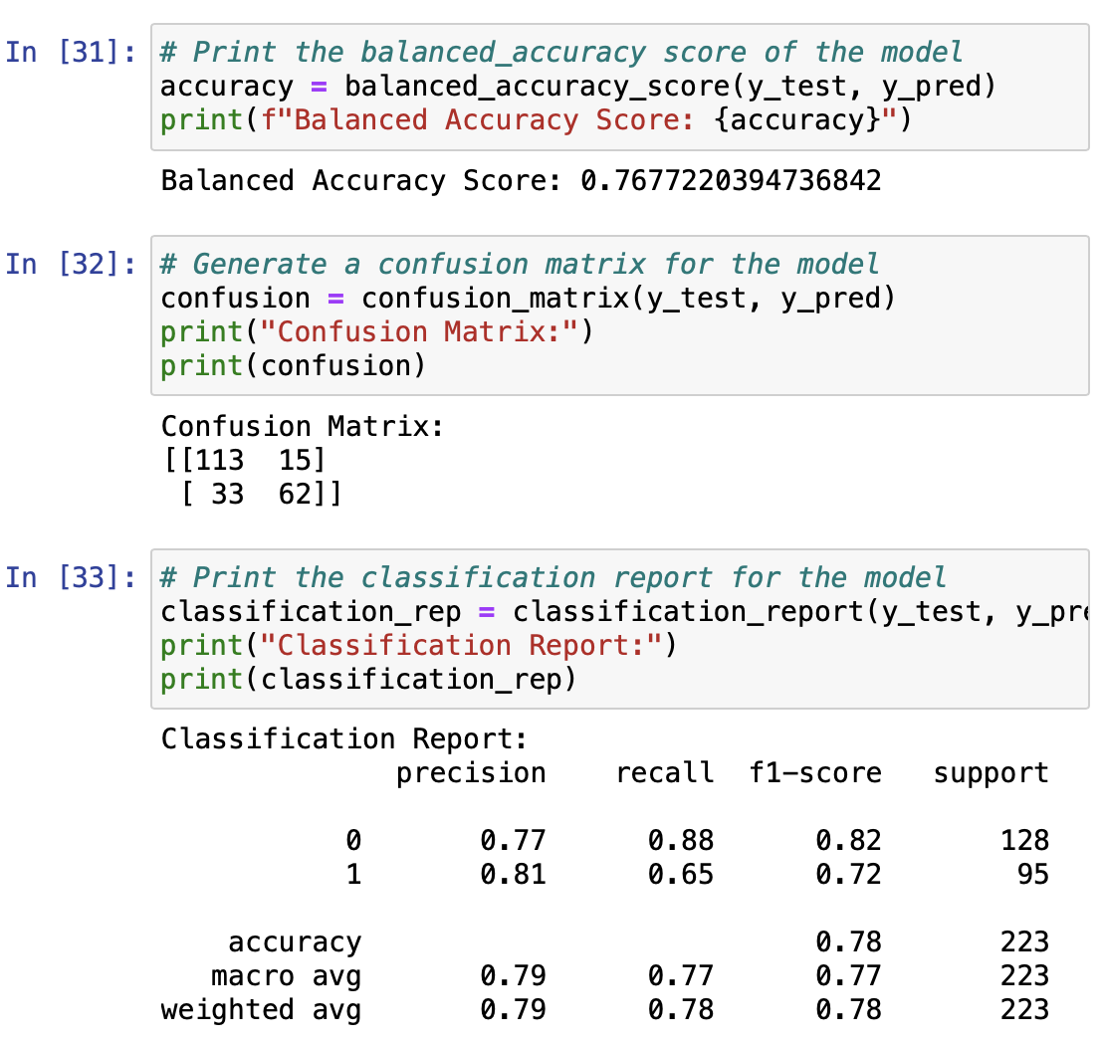
Machine Learning Model
Logistic Regression Model
Includes all columns except for:
Name
Ticket
Cabin
Embarked
Age (too many null values)
Accuracy score over 75%
Resampling technique yielded similar results
Surely socioeconomic status is the main predictive factor…right?

Slide 7
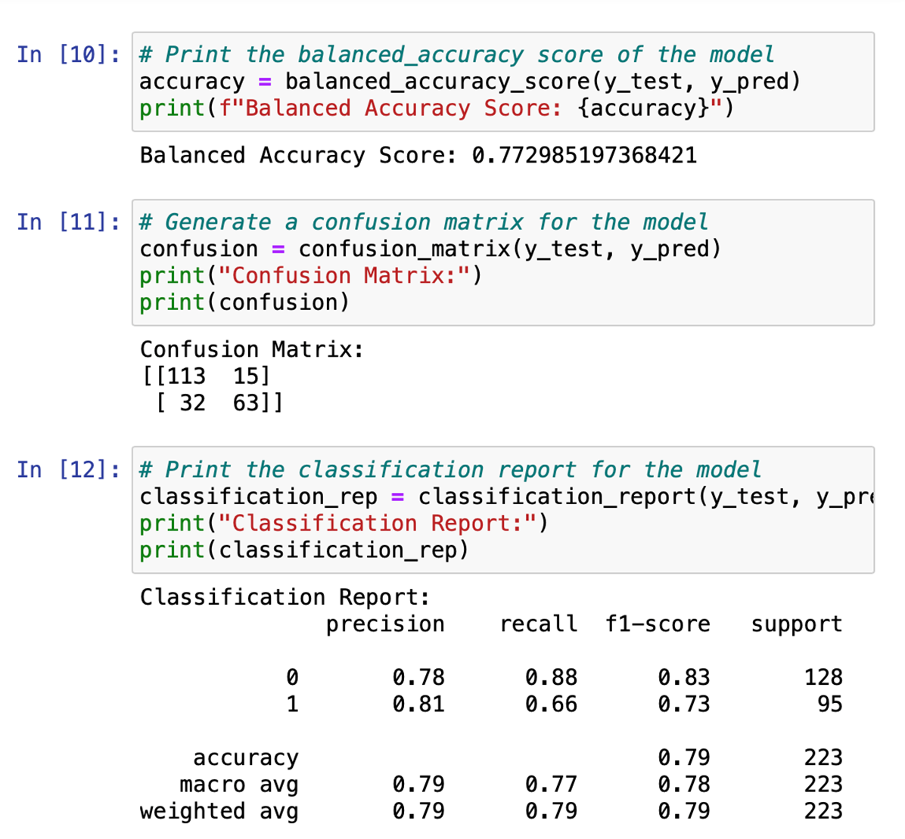
Machine Learning Model – Test 1
Testing Predictive Power of Socioeconomic Status
Includes all columns except for the ones mentioned in the previous slide as well as:
Pclass (ticket class of passenger; used as SES proxy)
Fare (price of ticket)
Accuracy score remained over 75%!
Resampling technique yielded similar results
So if wealth isn’t the main predictor for survival then what is?

Slide 8
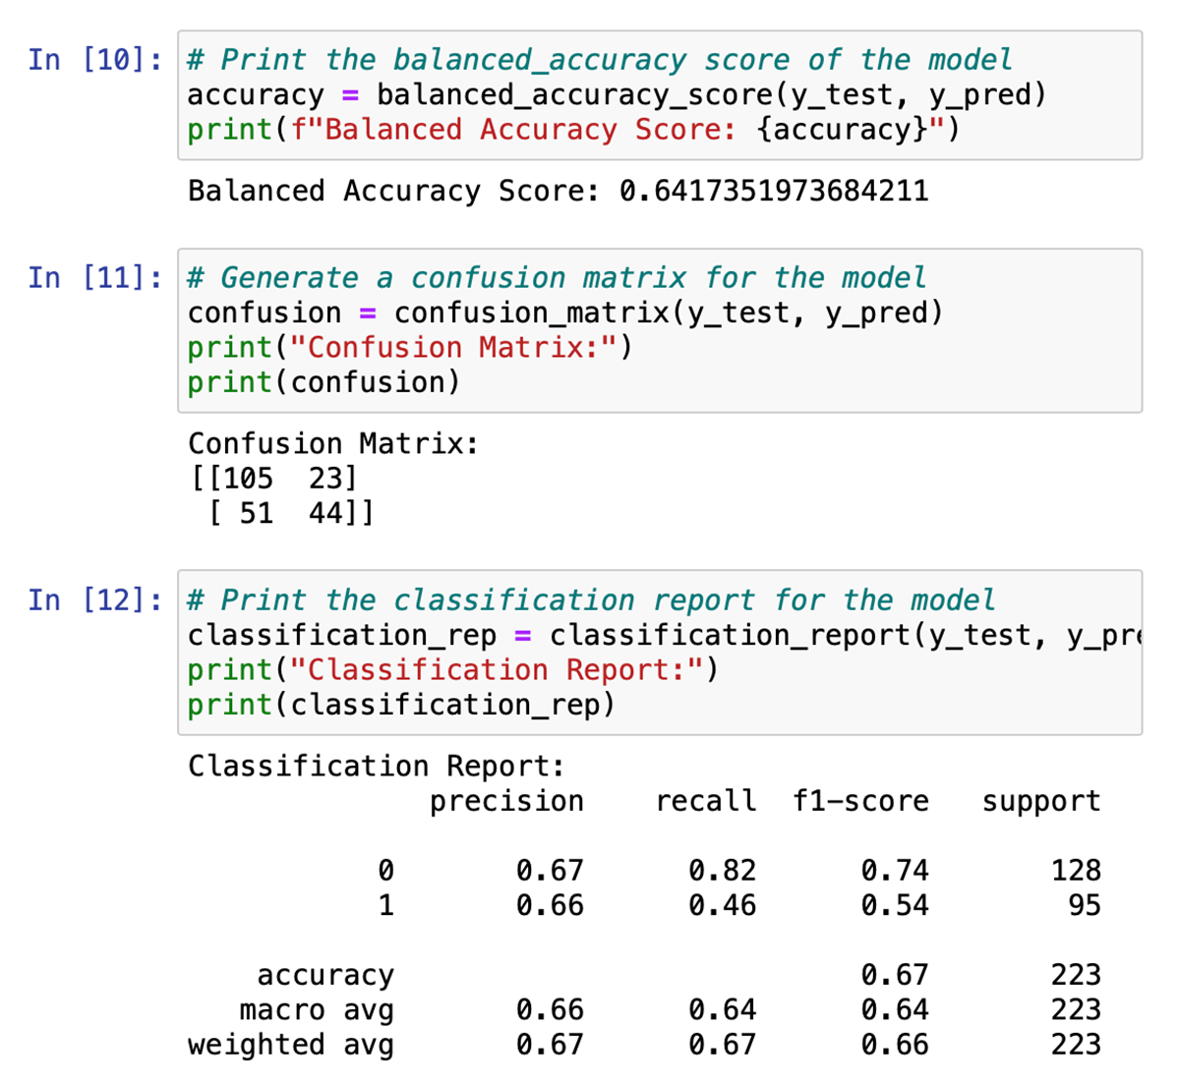
Machine Learning Model – Test 2
Testing Predictive Power of Gender
Includes all columns except for the ones mentioned in the first slide as well as gender
Accuracy score dropped significantly
Resampling technique yielded similar results
Gender played a much more significant role in the model’s ability to predict survival rates
Without either socioeconomic status or gender included, accuracy score drops to 50%

Slide 9
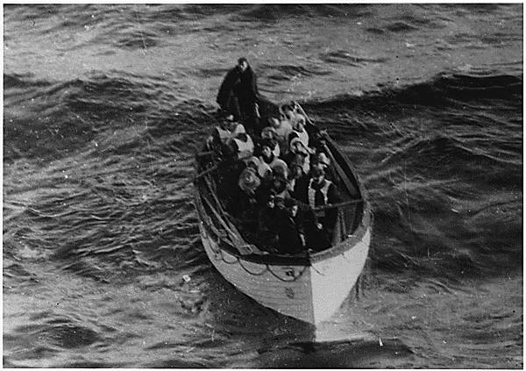
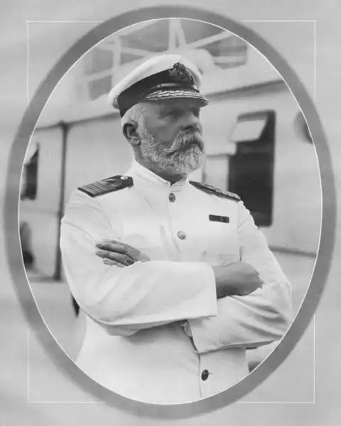
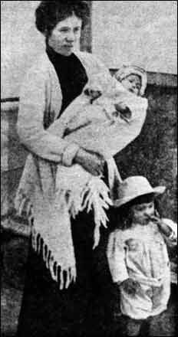
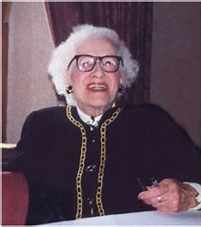
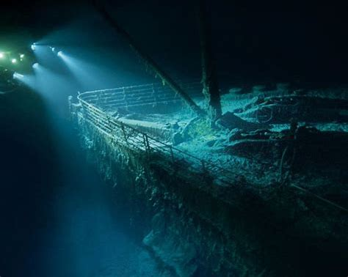
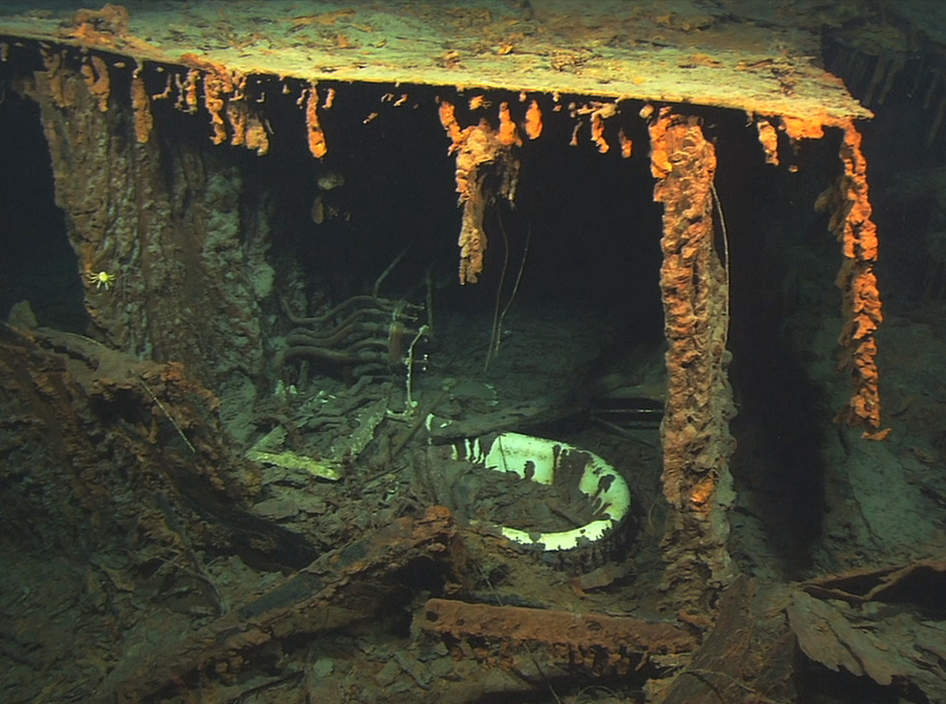
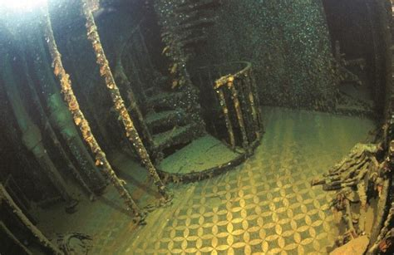
Interesting Facts
Captain Edward John Smith was the captain with over 40 years experience. He died in the disaster. His body was never recovered though it is rumored that he shot himself as the ship was sinking.
The youngest person on board was Millvina Dean, who was two months old when she was on the ship, was the last survivor. She died in 2009 at the age of 97. Her father died in the disaster.
Robert Ballard located the sunken wreckage in 1985. Fewer than 250 people have seen the remains of the ship as it is about 12,500 feet underwater.

Slide 10
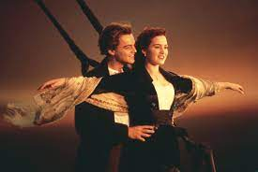
Questions?

